Slide 1
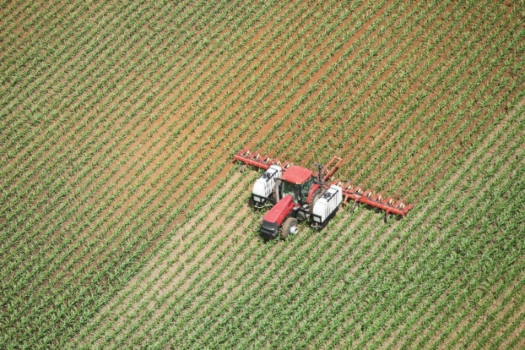
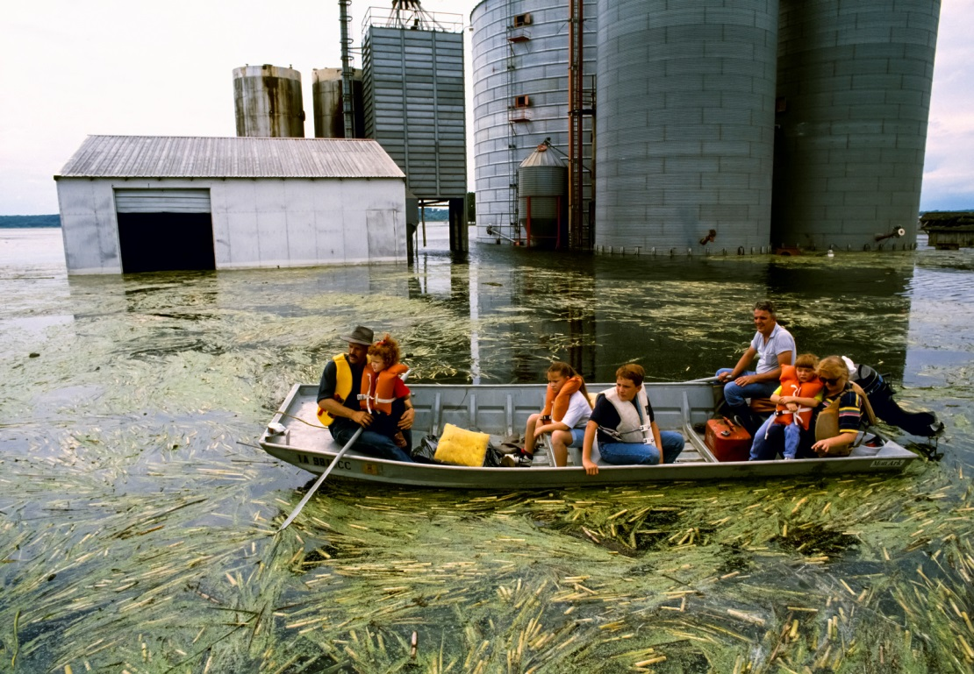
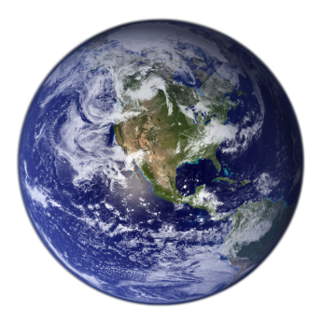
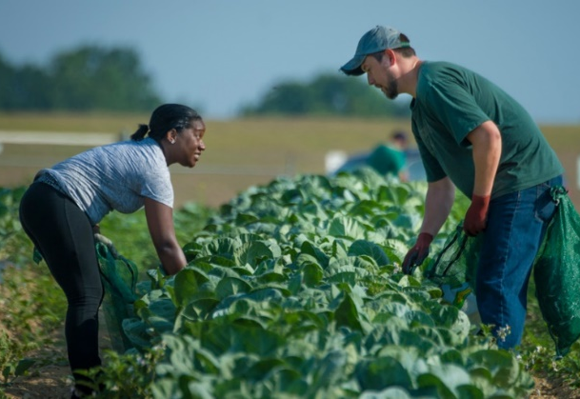
Climate Change & Agriculture
Connections, Science & Opportunities
Fibershed: Regenerating our Textile System
Session 3: Deepening Impact Assessments toward Social and Climate Goals, 31 Aug 2020
Credit: BanksPhotos/iStock
Credit: Russ Munn/AgStock Images
Credit: Preston Keres, USDA
Notes:
I am excited to be here to talk about connections between climate change and agriculture and why these connections matter in the context of the textile system.
Today I’ll give a little background on:
Impacts of ag systems – including food, fiber, and fuel, on our climate, environmental, and society
Tell you about science-based opportunities to leverage reimagined agricultural systems to being part of the solution to these challenges – including for both reducing harmful atmospheric emissions AND in terms of creating agricultural systems that are more resilient to the changes that are already happening.
Walk you through a case study to show you what this means for textiles, and why a holistic perspective is important, and finally
Briefly touch on the challenges and opportunities

Slide 2
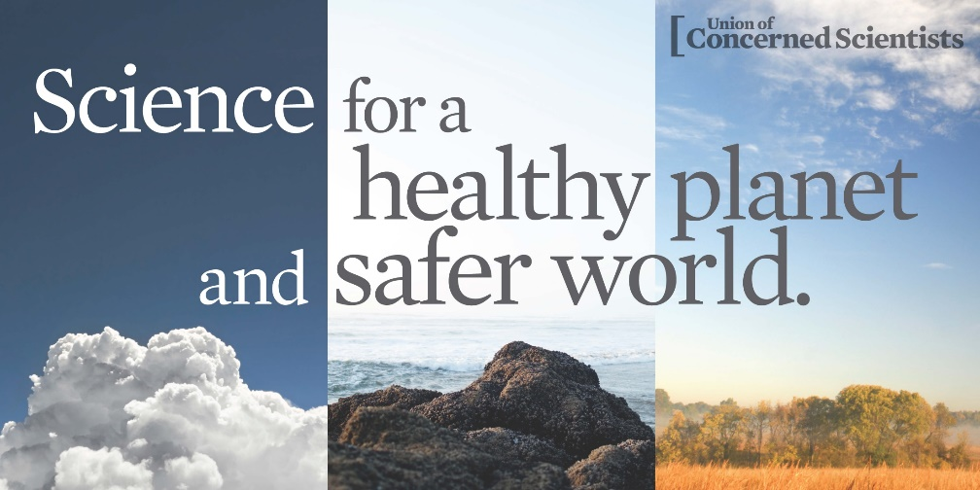
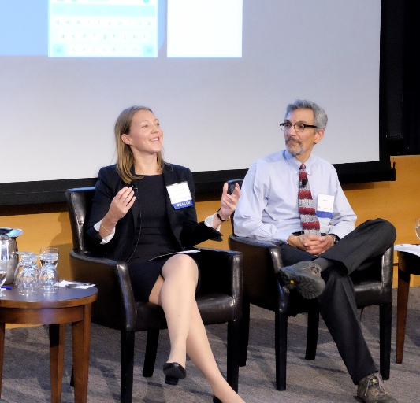
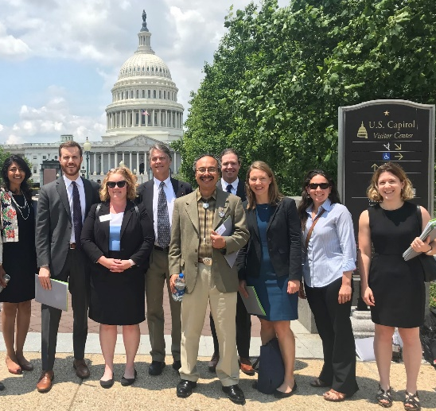
Marcia DeLonge, PhD
Research Director & Senior Scientist
Food & Environment Program
Union of Concerned Scientists
Toward Healthy Food & Farms
Transforming our food system to ensure
healthy, sustainably grown food for all.
Notes:
Before I dive in I’d like to share a bit of background on who I am and where I’m coming from
In brief, I’m a scientist with a background in environmental science, including soil science and agroecology – I met Rebecca while I was doing postdoctoral work at UC Berkeley on opportunities to manage rangelands as part of the climate change solution, which I’ll come back to later.
But for the past 6 years I’ve been working as a scientist at the Union of Concerned Scientists, a non-partisan, non-profit advocacy organization that works to put rigorous science to work to build a healthier planet & safer world
UCS has been around for ~50 years, have a staff of around 250 people, have ½ million members, and work on a variety of issues including: sea level rise, clean energy, clean vehicles, and food and agriculture – which is the team I’m on.

Slide 3
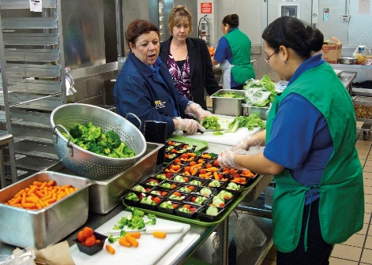
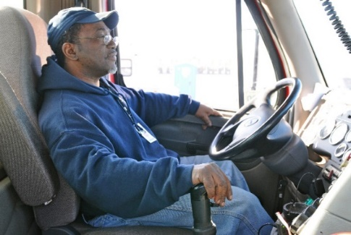
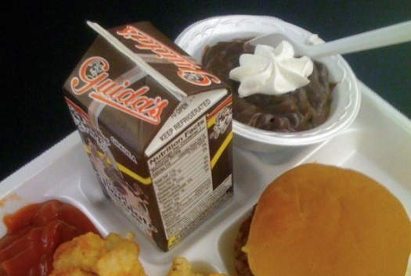
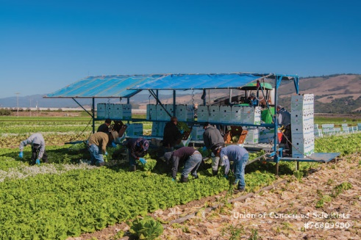
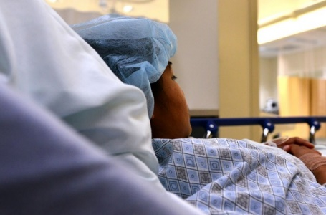
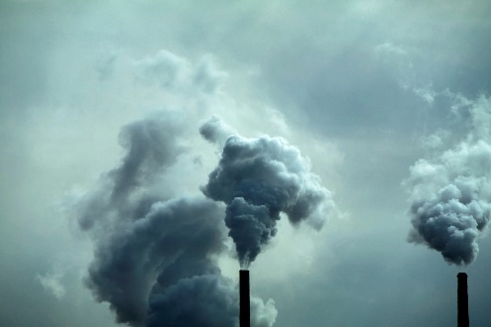
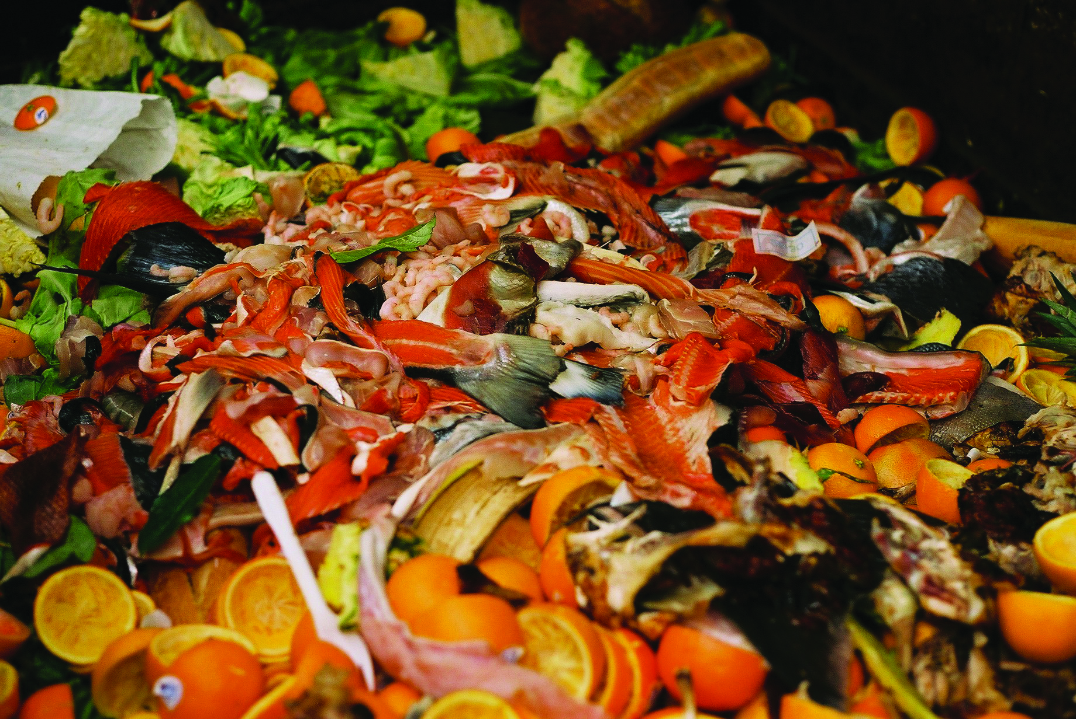
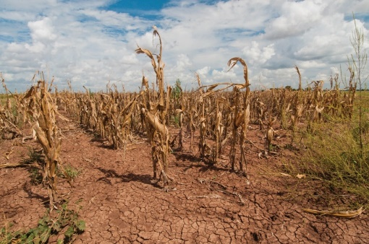
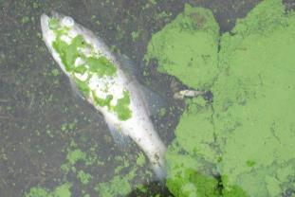
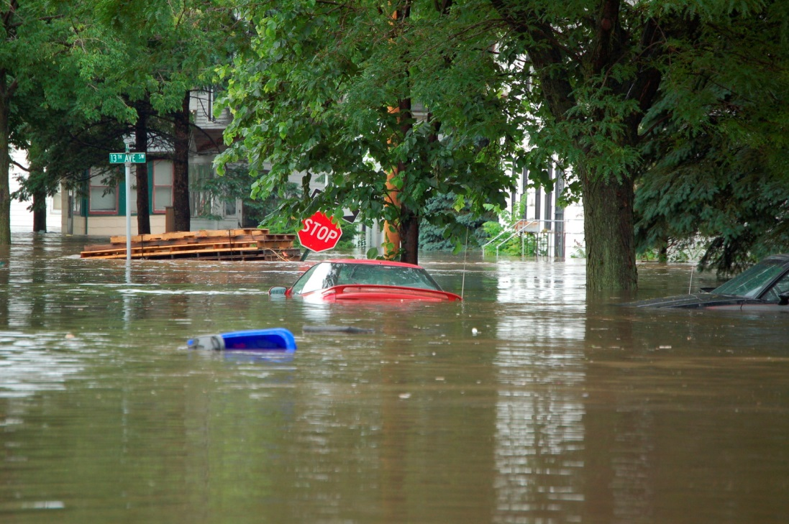
Impacts of Agricultural Systems
Notes:
Unfortunately, today’s agricultural systems fall far short of that vision, which brings me my overview of the impacts of agricultural systems on climate, environment, and society
We focus on food systems, so that’s the focus here, but I hope you’ll see that there are many parallels to the fiber system.
The other takeaway is that - as we move towards a better system - there is a lot of room for improvement
60% Americans live with at least one chronic disease
food insecurity rates remain high (12% in 2017)
labor force routinely exploited - food industry employs 1 in 7 US workers and pays the lowest hourly median wage of any major industry
40% of food is wasted
Food is produced in ways that: pollute and deplete water, produce climate emissions, degrade soils, and reduce farm resilience to conditions that are worsening with climate change such as droughts, floods, and extreme heat

Slide 4
Agriculture impacts climate change
Climate change impacts agriculture
Credit: BanksPhotos/iStock
Credit: Russ Munn/AgStock Images
Credit: Preston Keres, USDA
Notes:
And climate change has a particularly important role to recognize in all of this
First, agriculture today contributes significantly to climate change by contributing heat-trapping emissions
Climate change – combined with farm management – is worsening droughts, floods, and extreme heat – with both environmental and social consequences
But there’s a silver lining to this connection, which is that there are opportunities to farm in ways that reduce climate change and increase climate change resilience.

Slide 5
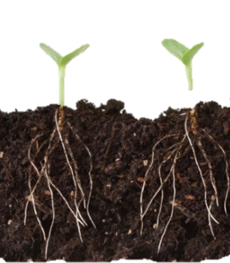
Healthy soils & farms
as a climate change solution
CO₂
Principles
Keep soils covered
Maintain living roots
Minimize disturbance
Add diversity
For example:
Cover crops
perennials
no-till
Grazing land management
Organic amendments
C₆H₁₂O₂
N, P
water
Notes:
And the reason for this has a lot to do with healthy soils.
Unhealthy soils tend to lead to losses of carbon, as well as water, nutrients (as pollution) and soils, and farming on these soils often relies on more inputs like fertilizers and fuels – costly & contribute to climate chnage
But healthy soils, managed well, can store and sequester a lot of carbon AND bring other co-benefits, like reducing water pollution and increasing resilience to floods
Several farming practices – on both croplands and rangelands – can help build soil carbon and soil health – and thereby be leveraged as part of the solution to the climate crisis.
There’s a growing body of science on a variety of practices, but I want to turn to one example as a case study, and connect this back more specifically to textile systems
----
Soils store a lot of carbon; More organic C in soil than vegetation + atmosphere (1417 billion tons in top 1 m)

Slide 6
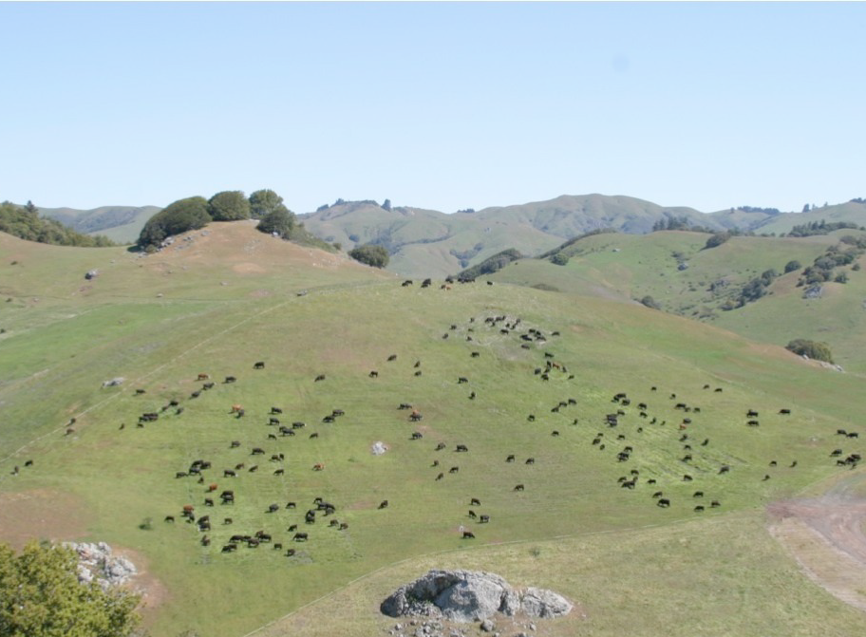
Opportunities for agricultural management as a climate solution: Marin Carbon Project
+ 40-70% forage
+ >1 Mt Soil C/ha
+ 26K L/ha soil water
Net climate benefit
Notes:
The case study is the Marin Carbon Project, which as I mentioned earlier is the scientific study I was participating in when I first met Rebecca.
The purpose of this research project was to learn whether grassland management – by applying compost- could be a viable climate solution. And over 10 years of research led to some extremely compelling results:
1. This picture shows four of the study plots, but I’ve just noted the location of the two that received compost in the blue boxes. You’ll notice that the cows are concentrated in these areas, and what the cows were noticing is that…
2. These areas greened up earlier, stayed greener longer and grew up to 50% more forage – or that plant material above ground they can eat.
-But for the purposes of this talk, the key takeaway was that the management strategy led to significant increases in both soil C and soil moisture, and when we did a full life cycle assessment, we found that the practice of producing compost from waste materials and adding them to rangelands could actually lead to a net reduction in greenhouse gas emissions.
This raised the question – if agricultural management changes could lead to a net climate benefit, how could those changes be integrated into and valued within the supply chains of key agricultural products, which brings me back to textiles and why a holistic perspective is important.

Slide 7
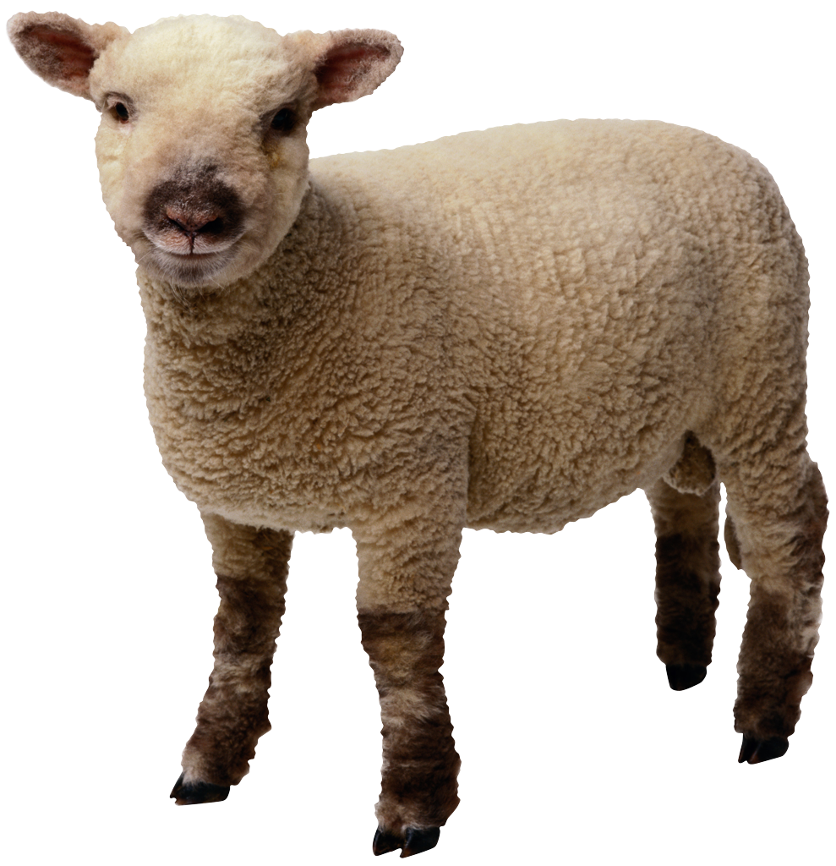
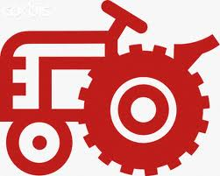
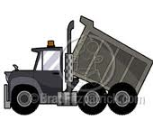
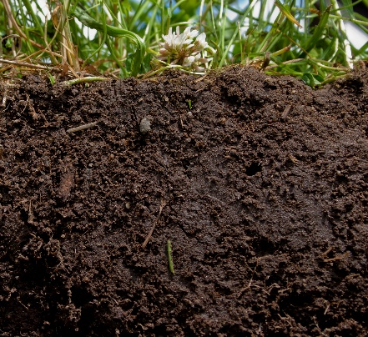
Life cycle of a garment:
Fiber production
Dye production
Transport & production
Care
Disposal
+
+
+
+
+
Fiber production
Dye production
Transport & production
Care
Disposal
Notes:
Here, let’s first take a step back.
When it comes to a garment, the full “life cycle” would include all of the energy, materials, and water that go into producing it, and how it interacts with its environment during its lifetime,
This cartoon shows a conceptual life cycle diagram representing wool production, dye production, transportation, production, maintenance and disposal.
And, in light of all we have covered today, what I want to draw your attention to is that land – and soil – is implicated in several stages of this lifecycle.

Slide 8
Life cycle of a garment:
Impacts & opportunities
CO₂
CO₂
CO₂
GHG
GHG
GHG
GHG
GHG
GHG
GHG
GHG
+
+
+
+
+
H₂O
H₂O
H₂O
H₂O
H₂O
H₂O
H₂O
H₂O
H₂O
H₂O
Fiber production
Dye production
Transport & production
Care
Disposal
Notes:
Further, if we want to think about the impacts and opportunities in the life-cycle of any product, that means considering those impacts – such as greenhouse gas emission and water impacts, at every stage along the way.
And it’s critical to remember that at some stages – thanks to the role of the land – it’s possible to actually reduce – rather than just minimize – climate impacts.
There’s a lot more research needed, but I think what’s clear is the need for this kind of big picture perspective – and one that considers the role of the soil, land, and agricultural system management.

Slide 9
Life cycle of a garment:
Impacts & opportunities
Climate emissions
Climate adaptation & resilience
Water pollution
Water depletion
Biodiversity
Social impacts
Notes:
I can’t end without pointing out that of course different garments would have different life cycle stages, as well as different impacts and opportunities.
And that ideally these types of analyses will be expanded to consider a range of environmental and social impacts, thinking back to the many harms caused by today’s systems and the opportunity to transform them in ways that address many issues at once.

Slide 10
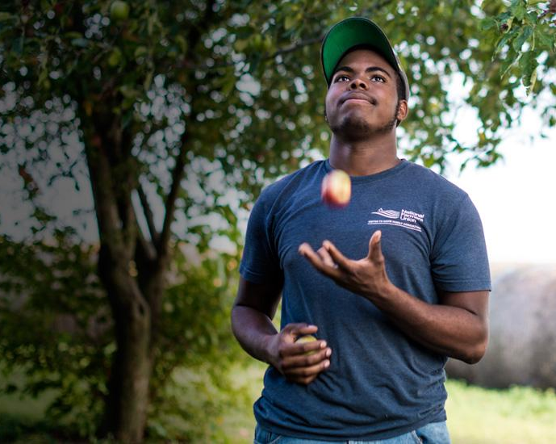
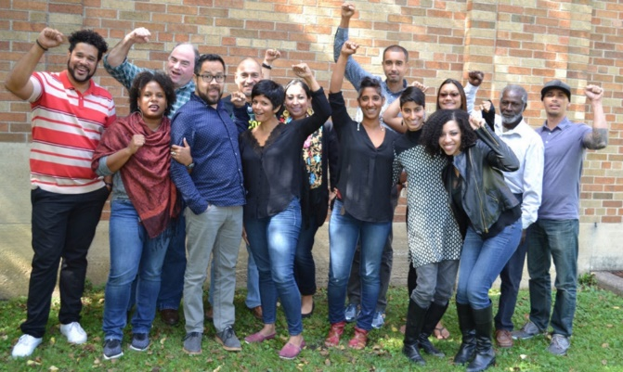
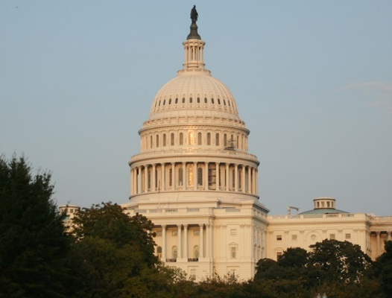
Climate Change & Agriculture
Obstacles & Opportunities
Scale of challenge
Logistical challenges
Measuring carbon change
C sequestration rates & saturation
Net GHG accounting
Science – demonstrating opportunity
Growing interest – farmers, consumers, companies
Policy momentum – states, federal
Credit: Preston Keres, USDA
Credit: HEAL Food Alliance
Credit: Eric E Johnson/CC (Flickr)
Notes:
To wrap up, I want to take a moment to acknowledge that there are a lot of obstacles and opportunities when it comes to climate change and agriculture – in general and in terms of the connections to textiles.
To name just a couple, of course the scale of the challenge is enormous, which is why we need all hands on deck.
And while the science has advanced tremendously, there are still questions that need to be answered.
However, I am increasingly encouraged by the momentum I’ve observed, with growing interest among scientists, farmers, consumers, companies, and policy-makers at both the state and federal level.
Hopefully, these forces will all work together to make agricultural solutions to climate change – as well as to other environmental and social challenges - even more viable, scalable, and effective
Thank you!

